Slide 1
YOUNG
WORKERS
HOW TO SUPPORT THEM TO STAY HEALTHY AND SAFE AT WORK
Notes:
Who is this presentation for?
This 40- 45 minute presentation (without discussion and questions) is designed to be delivered to groups of employers, supervisors, managers of young workers. Employers, supervisors, and managers of young workers have the greatest influence on their attitude to Work Health and Safety (WHS).
The presenter notes are broken down into discussion points, actions and session activities for each slide (where applicable), followed by background information for the presenter should they want more detail.
Make sure you allow time for questions and answers.
General tips for delivering an effective presentation:
The speaking points throughout this presentation provide guidance on what can be said to complement the presentation slides.
Adapt the presentation slides and speaking points to suit your presentation style, audience and what you want to achieve.
Include relevant experiences and stories where possible (we have provided quotes from young workers’ own experiences to help assist you in this).
Set aside time for questions and discussion. Focus on creating a positive discussion that motivates the audience to apply the information and ideas presented.
Find a suitable room or area within the workplace that is comfortable and free from distractions.
This presentation requires you to play videos, so you’ll need suitable speakers for the room size.
You will need to print out the following handouts:
young workers co-branded with Youthsafe.
young workers and mental health co-branded with Youthsafe.
your rights at work fact sheet

Slide 2
ABOUT THIS PRESENTATION
SECTION 1:
What does the law say?
What makes young workers unique?
SECTION 2:
The importance of appropriate training and supervision
How to engage young workers
Where to find more information and support
Notes:
This presentation is divided into two sections, which can be delivered separately depending on your time constraints.
Section 1 typically takes 20-25 mins
Section 2 typically takes 15 - 20 mins

Slide 3
WHAT DOES THE LAW SAY?
WHAT MAKES YOUNG WORKERS UNIQUE?
SECTION 1

Slide 4
NSW WORK HEALTH AND SAFETY ACT 2011
“Businesses... have a legal duty to ensure so far as is reasonably practicable:
a healthy and safe work environment
information, training, instruction and supervision is provided
the health of workers and workplace conditions are monitored
maintenance of safe systems of work.”
“Health... is both physical and psychological.”
“Workers... must:
follow any reasonable instructions, policies, procedures
take reasonable care of themselves and that of others.”
“Consultation... must occur on all work health and safety matters”
Notes:
BACKGROUND INFORMATION FOR SPEAKER
Relevant sections of the NSW Work Health and Safety Act 2011:
s.4 defines ‘Health’ as both physical and psychological.
s.17 and s.19(3)(a)
Management of risks
The management of hazards includes identifying hazards, assessing the risks and controlling the risks in so far as is reasonably practicable. This process includes:
hazard identification
management of risks
control of risks
The SafeWork Australia publication A Work-related psychological health and safety: A systematic approach to meeting your duties provides guidance to anyone who has a WHS duty to prevent and manage harm to workers’ psychological health. https://www.safeworkaustralia.gov.au/doc/work-related-psychological-health-and-safety-systematic-approach-meeting-your-duties
s.19(3)(c)
Safe systems of work
Is there a risk management process that considers physical and psychosocial hazards?
Are there systems of work and policies for dealing with relevant psychosocial hazards (workload, hours of work, consultation, flexible work practices, performance, role clarity, reporting lines, change management, professional development and reward, workplace bullying, occupational violence, work-related fatigue etc.)?
How are the policies consulted on, implemented and enforced?
Do you have a transparent complaints handling system (informal and formal)?
Does the formal complaints handling system include principles of natural justice, procedures for reporting, investigation, resolving complaints and an appeals process?
Are complaints handled in accordance with the procedures?
Does the organisation have a hazard reporting system in place that encompasses?
Are follow up actions taken in a timely way in response to reported issues?
s.19(3)(f)
information, training, instruction or supervision
Have workers been trained in workplace policies and procedures?
Is the training tailored to meet the specific needs of the workforce, e.g. age, language and literacy levels?
s.27(5)(a–g)
Duty of officers (Due Diligence)
Officers, including company directors, have legal obligations to make sure their business complies with work health and safety (WHS) legislation. This includes taking reasonable steps to:
a)Acquire and keep up-to-date knowledge of work health and safety matters, and
b)Gain an understanding of the nature of the operations of the PCBU’s business or undertaking and generally of the hazards and risks associated with those operations, and
c)Ensure that the PCBU has available for use, and uses, appropriate resources and processes to eliminate or minimise risks to health and safety from work carried out as part of the conduct of the business or undertaking, and
d)Ensure that the PCBU has appropriate processes for receiving and considering information regarding incidents, hazards and risks and responding in a timely way to that information, and
e)Ensure that the PCBU has, and implements, processes for complying with any duty or obligation of the PCBU under WHS legislation.
s.47
Duty to consult workers
This would be reflected in discussions with Health and Safety Representatives (HSRs), toolbox talks, minutes, agendas, speaking to workers, records from changes to processes, policies or procedures.

Slide 5
THE TEEN BRAIN
Notes:
ACTION
Play video, if hyperlink doesn’t work use URL https://youtu.be/f9Ya0mHsIgM
Handout fact sheet titled ‘Young Workers’, and co-branded with Youthsafe.
SPEAKER DISCUSSION POINTS
During adolescence the brain is experiencing one of the biggest periods of growth and is maturing both cognitively and emotionally.
The front part of the brain, the prefrontal cortex, is remodelled last. The prefrontal cortex is the decision-making part of the brain. It is responsible for your ability to plan and think about the consequences of actions, solve problems and control impulses. Changes in this part continue into early adulthood (mid 20s).
As the prefrontal cortex is still developing, young adults might rely on a part of the brain called the amygdala to make decisions and solve problems more than adults do. The amygdala is associated with emotions, impulses, aggression and instinctive behaviour.
According to studies, peer pressure has an effect on brain signals occurring in the risk and reward area of the brain. Compared to adults, teenagers were much more likely to take risks when their peers are around than when on their own.
Peer pressure can be difficult for teenagers to deal with, and learning ways to say “no” or avoid pressure-filled situations can become overwhelming. Positive role models (mentors, supervisors, and managers) in the workplace are essential in empowering young workers to stay healthy and safe at work.

Slide 6
BULLYING AND VIOLENCE AT WORK
Young workers are at risk because they:
have no or limited experience
are generally unfamiliar with workplace procedures
are unsure of their rights
are less likely to speak up.
Notes:
SPEAKER DISCUSSION POINTS
Many young people will experience violence, harassment and bullying in the workplace. Even through others in the workplace e.g. customers or volunteers. Workplace violence is never right and it is never just part of the job. Sadly many young people may be exposed to workplace violence.
Workplace violence includes behaviours such as:
physical violence (spitting, throwing objects)
verbal abuse (threats, sneering, demeaning comments)
leering, eye rolling and other rude behaviour
which is not acceptable normally in society.
It can result in not just physical injuries but deep emotional wounds to workers, often which go untreated and undiagnosed for years. Even verbal abuse and rude behaviour has been found over time to have devastating effects on worker health. Workplace violence is a serious safety issue and should be reported to your employer immediately. SafeWork NSW takes these matters seriously and can provide advice on preventing and managing these risks. It can also be a criminal offence and should, in these instances, be also reported to the police.
Immediately after a violent incident, you should consider:
allowing the worker time off to recover which may be only 15 minutes. This should be offered even to workers who appear ok or if they look like they haven’t sustained physical injuries. At this time provide support immediately afterwards by checking in with the worker.
follow up, even if the worker doesn't take time off work, with frequent checks. Offer if possible counselling or other forms of professional support, such as referring the individual to their own treating doctor.
Workplace bullying is defined as repeated and unreasonable behaviour directed towards a worker or group of workers that creates a risk to health and safety.
Bullying can take different forms including psychological, physical or even indirect—for example deliberately excluding someone from work-related activities. It can be obvious and it can be subtle, which means it’s not always easy to spot.
Some examples of workplace bullying include:
abusive or offensive language or comments
aggressive and intimidating behaviour
belittling or humiliating comments
practical jokes or initiation
unjustified criticism or complaints.
The true extent of workplace bullying and harassment is difficult to measure as young people are less likely to make reports because of the difficulties of making claims and because of concerns about the impact of reporting on their job.
(Information sourced from Australian Human Rights Commission -https://bullying.humanrights.gov.au/violence-harrassment-and-bullying-children-and-young-people-5#fn85)
The studies have shown that not only the targets of bullying, but also bystanders, suffer when someone is bullied in the workplace. Bullying must therefore be regarded as a problem for the entire work unit and not merely as a problem of the target.
ACTION
Handout the fact sheet titled ‘Young workers and mental health’, as extra reading for later.
BACKGROUND INFORMATION
You may consider raising the topic of the bystander effect in regards to bullying as leaders in the organisation play an important role in setting the tone of the workplace and what is and isn’t acceptable behaviours, “the standard you walk past is the standard you accept” - David Hurley (General Australian Army) also made famous by David Morrison (Lieutenant General Australian Army).
A bystander could be anyone who sees or otherwise becomes aware of behaviour that appears worthy of comment or action.
A responsible bystander may be able to react immediately and on the spot, at times when action is safe and appropriate. This may be more effective in affirming good behaviour or discouraging unacceptable behaviour than are reactions that are delayed. In addition, affirming useful innovations and catching errors on the spot may be more cost effective than are delayed responses. (Bystander Training within Organizations_Maureen Scully and Mary Rowe: Journal of the International Ombudsman Association_ 2009)

Slide 7
WHAT YOUNG WORKERS SAY
“I was asked to work early and late at age 15-16, without any supervision.
At this time I was solicited for sex by a customer…
I said no and kept working.”
- Female, 21, Integration Aid
“It was a very dangerous installation job for the whole team and if I were to speak out they would tell me to f*** off.”
- Male, 21, Cabinetmaker
“I was new and wanted to listen to what my manager told me to do. Other people were doing it as well so I thought it was only normal to be doing that task.”
- Female, 19, Customer service
“You have to consistently be polite to rude and sometimes cruel customers. This is pretty related to Trip Advisor and the stigma in a rural town of having to keep a high rating even if it means putting up with rude customers.”
- Female, 23, Food Service Assistant
“I would like to know more about how to handle workplace bullying as at the moment I feel like I am being bullied by my co-worker and our supervisor. I want to face this issue the wise and smart way not just me getting sick of it then just ready to explode.”
- Female, 19, Waitress
Notes:
SESSION ACTIVITIES
You can use these quotes to generate discussion, it’s the reality of what’s happening to some young workers.
Ask participants to pick a colour and break up into groups.
Role play a young worker coming to their supervisor and telling you about this scenario saying these comments.
Consider what appropriate response and actions the supervisor would take.
Remember to reinforce the positive behaviour of young workers speaking up and asking their supervisor for help.
Comments sourced from - http://www.youngworkers.org.au/publications
BACKGROUND INFORMATION FOR SPEAKER
Leadership is crucial
Employers, supervisors, managers and other leaders of young workers have the greatest influence on their health and safety as well as their attitude towards safety. They can help create healthy and safe environments for young workers by:
providing the right tools, training and supervision to complete their work safely
educating them about their WHS rights and responsibilities
empowering them to have the confidence to speak up about health and safety in the workplace, and
fostering a positive workplace culture that engages young workers in WHS.
(Information taken from SafeWork Australia - https://www.safeworkaustralia.gov.au/young-workers)
The following slides will explore the important aspects that employers, supervisors, managers and other leaders of young workers should be aware of.

Slide 8
BRODIE’S STORY
Notes:
SPEAKER DISCUSSION POINTS
In September 2006, 19-year-old Brodie Panlock ended her life after enduring ongoing humiliating and intimidating bullying by her co-workers at a café in Hawthorn. Her death is a tragic reminder of the serious consequences that bullying can have on victims, their families and the community.
ACTION
Play video, if hyperlink doesn’t work use URL https://www.youtube.com/watch?v=uJ0WkM6mEyg&gl=AU&hl=en-GB
The following slides will explore the important aspects that employers, supervisors, managers and other leaders of young workers should be aware of.

Slide 9
THE IMPORTANCE OF TRAINING AND SUPERVISION
HOW TO ENGAGE YOUNG WORKERS
WHERE TO FIND MORE INFORMATION AND SUPPORT
SECTION 2

Slide 10
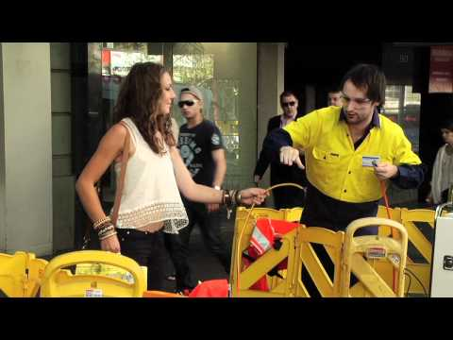
WOULD YOU SAY YES?
Source: WorkSafe Victoria
Notes:
ACTION
Play video, if hyperlink doesn’t work, use this URL https://www.youtube.com/watch?v=YVrVgrhbV7w&t=2s
SPEAKERS DISCUSSION POINTS
Despite being warned the cable was dangerous, a staggering 90 percent of people walking down Bourke Street in Melbourne who were asked by the ‘supervisor’ to pass the live wire to the ‘apprentice’ did as they were told. Even when the apprentice received a (fake) ‘shock’ and dropped the cable, the helpful passers by picked it up and handed it to him again.
The experiment was based on a series of psychological experiments conducted by Stanley Milgram in the 1960s, which highlighted people’s willingness to obey requests from authority figures, even if those requests were harmful to themselves or others.
Also reflecting on what we looked at earlier and the brain’s development and studies around peer pressure. Young workers will follow the behaviours of other workers in the workplace. Leadership at every level is crucial to having a healthy and safe workplace.
So ensure that all your workers are properly trained and understand the correct procedures to work healthy and safe.
You need to empower young workers so they have the confidence to ask questions if they’re unsure about a task.

Slide 11
WHY TRAINING & SUPERVISION IS IMPORTANT
How well do you provide training and supervision in your workplace?
Have you ensured the person you’re training understands what you expect from them?
Ask them questions to ensure their understanding.
Get them to demonstrate the task in front of you and check in with them to make sure they’re not having any issues or difficulties.
Notes:
SESSION ACTIVITY
(Listening task to demonstrate the importance of proper training and supervision)
Directions
After giving each participant one sheet of paper, offer the following directions, pausing after each instruction to give the group time to comply .
1. Pick up your sheet of paper and hold it in front of you. Close your eyes and listen carefully to my directions. The rules are: (1) no peeking and (2) no questions.
2. The first thing I want you to do is to fold your sheet of paper in half. (Pause)
3. Now, tear off the upper right hand corner. (Pause)
4. Fold the paper in half again and tear off the upper left hand corner of the sheet.(Pause)
5. Fold it in half again. (Pause)
6. Now tear off the lower right hand corner of the sheet. (Pause)
SPEAKER DISCUSSION POINTS
After all tearing is completed ask participants to open their eyes and unfold their paper.
Ask the following questions:
Did I do a good job of communicating and did you do a good job of listening?
Do all of our sheets look exactly the same?
Ask participants to compare their sheets?
Why does no one’s paper match exactly?
You will probably get responses such as, “You didn’t let us ask any questions!” or “The way you gave us directions wasn’t clear!”. However this activity is to demonstrate that providing just written instructions or just telling workers , isn’t effective.
Key messages – Have you ensured the person you’re training understands what you expect from them. Ask them questions to ensure their understanding, get them to demonstrate the task in front of you and check in with them to make sure they’re not having any issues.
Also remember we have discussed earlier your legal obligation to provide information, training, instruction and supervision. Training is one of the best ways to ensure workers are safe at work. Providing them with effective training and adequate supervision will make them aware of safety issues and help them perform their jobs competently, consistently and safely.
BACKGROUND INFORMATION-
s.19(3)(f) –the provision of any information, training, instruction or supervision that is necessary to protect all persons
Have workers been trained in workplace policies and procedures?
Is the training tailored to meet the specific needs of the workforce, e.g. age, language and literacy levels?
Have supervisors and managers been trained in:
their role in the design and management of work to minimise the risk to the psychological health and safety of workers
effective performance management
understanding and dealing with mental health issues (for information on supporting your workers go to the Heads Up website https://www.headsup.org.au/)
minimising the risks of bullying, harassment or other unreasonable behaviours and responding effectively when it occurs?
Are workers provided with effective training and supervision?
This may be reflected in:
training records
inductions
training needs analysis
or talk to workers about their needs.
Have you thought about mentor, peer support programs in your organisation?
These types of programs can assist in supporting new workers and ensuring experience is valued within the organisation. SafeWork NSW runs a number of programs including the mentor program where businesses mentor others to improve their work health and safety.

Slide 12
WHO’S RESPONSIBLE?
WARNING: This video contains footage that some viewers may find distressing
Source: WorkSafe Victoria
Notes:
SPEAKER DISCUSSION POINTS -
“Listen carefully to the young worker’s inner monologue”.
ACTION
1.Play video ,if hyperlink doesn’t work, use this URL https://www.youtube.com/watch?v=uMecBA_MHfA
2. Explore with participants the safety controls you might have in your workplace to stop this incident from occurring.
Answers might include -
A policy that young or new workers don’t use the machine when unsupervised.
Training
Guidance material eg step by step instruction poster.
Reinforce the need for training and making sure that your young worker feels confident to say “no” to unsafe work and ask for help if they are uncertain. It’s better they speak up than risk being injured!
Introduce the key messaging to give to young workers to reinforce positive safety behaviour. When training young workers ask them to think about these actions before a task to reinforce safety behaviour.
Wait, Take, Five.
1. Stop…..
2. Is it safe?
3. Could it hurt someone?
4. Speak up.
5. Ask (for help or if they are not sure).

Slide 13
TIPS FOR ENGAGEMENT
Ask them “How are you going?”
Make it about them (talk about what their interests are)
Let them teach you (e.g. IT shortcuts, a different way of doing things)
Give them a choice where possible
Set them a challenge (inspire innovation and motivation)
Be yourself, be genuine
When having difficult conversations with a male try doing it shoulder to shoulder (it’s less confronting)
Encourage them to be involved in WHS consultation
Notes:
SPEAKER DISCUSSION POINTS
How do you make young workers feel comfortable and empowered to speak up? Do you regularly engage, consult?
Engaged workers are more productive workers and more likely to speak up to raise issues or concerns.
An example of shoulder to shoulder is when you are both standing next to each other and not face to face. There is no eye contact required and the young worker may be more receptive to your message.
ACTION
Handout the fact sheet titled ‘The basics: your rights at work’ as resources for participants to take back to give to their young workers.

Slide 14
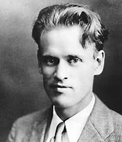
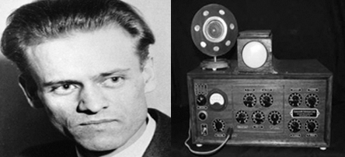
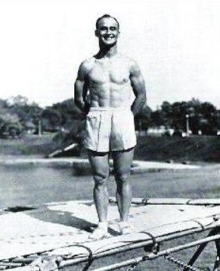
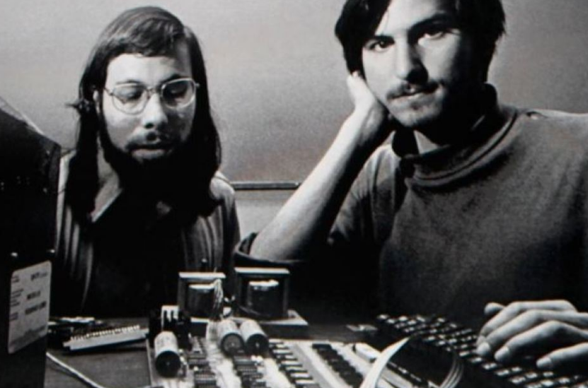
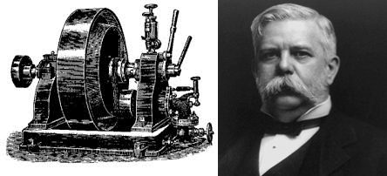
FAMOUS YOUNG INVENTORS
Mechanical calculator, Blaise Pascal –
22 years old
NSW Young Australian of the Year – ‘Smart Armour’ inventor
Macinley Butson
Television,
Philo Farnsworth – 21 years old
1623
1846
1906
1914
1976
2018
Apple co-founder
Steve Jobs and Steve Wozniak –
in their early 20s
Rotary Steam Engine,
George Westinghouse –
19 years old
Trampoline
George Nissen –
16 years old
Notes:
SPEAKER DISCUSSION POINTS
You will get the best out of young workers by ensuring they are properly trained, regularly engaged and empowered to speak up.
Young people can learn new things, approach challenging tasks in different ways, which can lead to innovation and better ways of doing things. Harvard University researchers found that the teenager’s brain is exceptionally malleable. The skills you learn during adolescence will be richer and more enduring than anything you learn at any other time of your life. Therefore the training you provide in relation to WHS now may set the tone and stay with them throughout their whole working life.
Here are some famous inventions created by people when they were young.

Slide 15
INFORMATION AND RESOURCES
SafeWork NSW - www.safework.nsw.gov.au
Access information and advice about consulting with workers, workplace bullying, stress, violence, fatigue, alcohol and other drugs
Heads Up - www.headsup.org.au
Gives employers the tools and knowledge to look after their staff and create a mentally healthy work environment
SafeWork Australia - www.safework.gov.au
Provides guidance material for managing and preventing workers becoming ill or sustaining a psychological injury.
Work and Development Order Scheme - www.revenue.nsw.gov.au
Supports young workers who have fines with the Department of State Debt Recovery to reduce their debt through unpaid work with an approved organisation or by undertaking certain courses.
Alcohol and Drug Foundation - www.adf.gov.au
Access information and resources about managing alcohol and other drugs in the workplace

Slide 16
Contact SafeWork NSW safework.nsw.gov.au 13 10 50 contact@safework.nsw.gov.au

