Slide 1
THE BASICS:
STAYING HEALTHY AND SAFE AT WORK
Notes:
Who is this presentation for?
This 40- 45 minute presentation (without discussion and questions) is designed to be delivered to groups of young workers by a workplace trainer, teacher, educator, careers counsellor, supervisor or manager.
The presenter notes are broken down into discussion points, session activities and actions for each slide (where applicable). Followed by background information for the presenter should they want more detail.
Make sure you allow time for questions and answers.
General tips for delivering an effective presentation:
The speaking points throughout this presentation provide guidance on what can be said to complement the presentation slides.
Adapt the presentation slides and speaking points to suit your presentation style, audience and what you want to achieve.
Include relevant experiences and stories where possible (we have provided quotes from young workers’ own experiences to help assist you in this).
Set aside time for questions and discussion. Focus on creating a positive discussion that motivates the audience to apply the information and ideas presented.
Find a suitable room or area within the workplace that is comfortable and free from distractions.
This presentation requires you to play videos, so you’ll need suitable speakers for the room size.

Slide 2
WHO’S RESPONSIBLE ?
WARNING: This video contains footage that some viewers may find distressing
Source: WorkSafe Victoria
Notes:
WARNING: This video contains footage some viewers may find distressing as it contains blood and people being hurt.
SESSION ACTIVITY
Step 1 - Play video https://www.youtube.com/watch?v=uMecBA_MHfA
Step 2 - Take a vote on who they believe was at fault for the young worker (girl) (Warning that incident occurs at approx. 0.24sec into video for people who wish to look away)
Vote - put your hands up if you think it’s entirely the young worker’s (girl) fault?
Vote - put your hands up if you think it’s entirely the employer’s (person who owns the business / lady on the phone)?
Vote – put your hands up if you think it’s both the employer (lady on the phone) and the young worker (girl)?
Step 3 – Ask the following questions
Why do you think that? Work through with the audience the reasoning of why they think that the individual(s) was responsible.
Do you think the young girl was properly trained to use the bread slicer? (Background Information for speaker - the young girl’s internal monologue suggests she was shown however is not confident in using it as she can’t remember).
What do you think would happen if the young worker said to the customer “sorry, do you mind waiting, I need to get my boss, I’m still in training and don’t know how to use the slicer yet”?
But what if the customer or her boss yelled at her for making the customer wait? Do you think it’s worth being possibly yelled at?
There are laws to protect your health and safety in the workplace and people that may be able to help / support you when things go wrong, if you get hurt or just aren’t shown correctly how to do your job. Today we’re going to explore your rights and where you can go for help.
BACKGROUND INFORMATION
Listen carefully to the young worker’s inner monologue.
The aims in showing the video is to promote discussion and affirm the importance why you’re talking about work health and safety.

Slide 3
WORK HEALTH AND SAFETY LAWS
Employer
Responsibilities
Provide a safe work environment.
Provide information, training, instruction and supervision.
Talk with you about health and safety.
Appoint a safety committee or safety representative if requested.
Your
Responsibilities
Take reasonable care of your health and safety.
Don’t endanger other people through your actions.
Follow reasonable instructions and policies
Your
Rights
Stop or refuse unsafe work.
No negative repercussions for raising health and safety concerns.
Elect a health and safety representative.
Source: State of Queensland (WorkCover Queensland)
Notes:
SPEAKER’S DISCUSSION POINTS
The law says that your employer must do all they can to ensure your job does not hurt you or make you sick. These laws are generally called the work health and safety (WHS) laws.
However, the laws also say that workers have responsibilities to: take reasonable care of themselves, as well as others.

Slide 4
YOUR SAFETY RESPONSIBILITIES AT WORK
ASK… if you are not sure how to safely perform the work
FOLLOW... instructions and work safely
REPORT... unsafe and unhealthy situations and injuries to your immediate supervisor
Notes:
SPEAKER’S DISCUSSION POINTS
This includes -
Be fit and well enough to do your job
Do not place yourself at risk of injury (or someone else)
Report hazards, injuries, incidents
Read and understand the employer’s policy and procedures and follow them
Do the job safely, in accordance with your training, procedures and equipment manuals
If you are not sure about something, ask someone for help.
NB: So the answer to the question in SLIDE 2: “Who is responsible?” is potentially both (the person who manages / owns the business and the young worker)
Report any work health and safety issues to your:
employer
host employer
labour hire company
group training organisation
work experience placement supervisor

Slide 5
WHO IS SAFEWORK NSW?
The workplace health and safety regulator in NSW
SafeWork NSW:
provides advice on improving work health and safety
issues licences and registration for potentially dangerous work
conducts investigations into workplace incidents and makes sure the work health and safety laws in NSW are followed.
Notes:
SPEAKER’S DISCUSSION POINTS
SafeWork NSW is New South Wales’ workplace health and safety regulator. The regulator makes sure laws are followed and provides advice and services on work health and safety.
They:
provide free advice and support on improving work health and safety
provide licenses and registration example for potentially dangerous work, plant equipment, white cards
investigate workplace incidents and enforce work health and safety laws in NSW
provide testing services e.g. workplace equipment (mechanical) (forklifts, conveyor belts, wire ropes), biological samples (urine), workplace environment sample testing (e.g. air, surfaces, noise)

Slide 6
YOUR FIRST DAY
You should be:
shown how to use any equipment that you will be operating
trained in how to use equipment safely
provided with safety equipment appropriate to your job. This is called personal protective equipment (PPE)
using PPE that is in good condition with knowledge of how to use and wear it
shown the workplace including entry and exit points, amenities and first aid areas
told about emergency evacuation procedures
introduced to your immediate supervisor, health and safety representative and people you will work with
told what to do if there is an injury.
Notes:
SPEAKER’S DISCUSSION POINTS
So a major part of the work health and safety (WHS) laws is making sure workers are provided with information, training and supervision throughout their time at work, this is especially important when you first start work. This information and training when you first start a new job is called an induction.
Under Work Health and Safety Regulations 2017, employers should ensure you receive:
Information on what the WHS policies and procedures are and where to find a copy of them.
Training to do your job safely (Clause 39 Provision of information, training and instruction)
Safe equipment, that is in good working condition (Clause 44 Provision to workers and use of personal protective equipment)
Access to amenities e.g. toilets, drinking water, washing facilities and eating facilities (Clause 41 Duty to provide and maintain adequate and accessible facilities)
How to access to a first aid kit and a certified first aid person (Clause 42 Duty to provide first aid). Also information about what to do and who to contact if they you sick or injured.
Information and understand the evacuation procedures.
ACTION - Distribute the handout (The Basics: Your Rights at Work) found via link - https://www.safework.nsw.gov.au/resource-library/the-basics-your-rights-at-work
note the checklist. The checklist will help you workout the things that are important to know how to work safety. The handout is also available in multiple different languages.

Slide 7
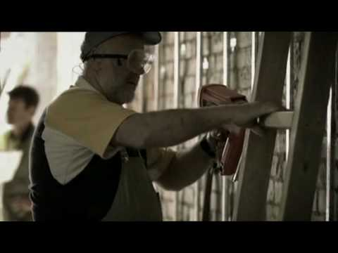
WHO’S RESPONSIBLE?
WARNING: This video contains footage that some viewers may find distressing
Source: WorkSafe Victoria
Notes:
WARNING: This video contains footage some viewers may find distressing as it contains blood and persons being hurt.
ACTION
Step 1 - Play video - WorkSafe Victorian (Nail Gun) https://www.youtube.com/watch?v=xBrYqSsaoP0
Step 2 - Take a vote on who they believe was at fault for the young worker (boy) (Warning that incident occurs at approx. 0.24sec into video for people who wish to look away)
Vote - put your hands up if you think it’s entirely the young worker’s (boy’s) fault?
Vote - put your hands up if you think it’s entirely the employer’s (person who owns the business) fault?
Vote - put your hands up if you think it’s entirely the supervisor’s (person who is meant to be looking out for the young worker) fault?
Vote – put your hands up if you think it’s both the supervisor and the young worker’s (boy) fault?
Step 3 – Suggested questions to ask
Why do you think that?
Work through with audience the reasoning of why they think that individual was responsible.
What was the PPE used in the video clip? (protective eyewear, earpieces, hi vis (high visibility) shirt)
Did you see any issues with the eyewear (PPE) the young worker was wearing? (possibly dirty)
If there was something wrong with the eyewear (PPE), what should the young worker have done?
Do you think someone should be supervising the young worker at all times?
Do you think he had been trained on how to use the nail gun? What if he was told not to use the nail gun?
Introduce messaging of Wait Take Five. This is a simple way to remember what actions you should take to stay safe.
1. Stop…...
2. Is it safe?
3. Could it hurt someone?
4. Speak up.
5. Ask. (for help or if they are not sure)

Slide 8
CONSULTATION AT WORK
Consultation is a two-way process between workers and their boss.
It gives workers the opportunity to talk about health and safety.
Workers can provide suggestions about how the work could be done safely and contribute to decision making.
Consultation must take place on all work health and safety matters but might look different in different workplaces, for example:
health and safety representatives
health and safety committees
briefing sessions
face-to-face discussions.
Notes:
SPEAKER’S DISCUSSION POINTS
We’ve covered off the first day at work but doesn’t mean work health and safety stops there. Employers have an ongoing requirement to continue to talk about work health and safety with you.
How does your workplace consult with you?????
health and safety representatives
health and safety committees
other arrangements with your workers, including:
toolbox talks
regular scheduled meetings where health and safety matters are on the agenda
one-off meetings
briefing sessions
face-to-face discussions.
Encourage young workers to find out if they have Health and Safety Representative (HSRs) and Health and Safety Committees (HSC) and put their hand up for nomination.
BACKGROUND INFORMATION : The following sections provides significantly more detail if required.
WHS Act 2011 Part 5 – Consultation, representation and participation
Section 47 -The person conducting the business or undertaking must consult, so far as is reasonably practicable, with workers who carry out work for the business or undertaking who are (or are likely to be) directly affected by a work health and safety matter.
Section 48 - If the workers are represented by a health and safety representative, the consultation must involve that representative.
Section 49 When consultation is required
Consultation under this Division is required in relation to the following health and safety matters:
(a) when identifying hazards and assessing risks to health and safety arising from the work carried out or to be carried out by the business or undertaking,
(b) when making decisions about ways to eliminate or minimize those risks,
(c) when making decisions about the adequacy of facilities for the welfare of workers,
(d) when proposing changes that may affect the health or safety of workers,
(e) when making decisions about the procedures for:
(i) consulting with workers, or
(ii) resolving work health or safety issues at the workplace, or
(iii) monitoring the health of workers, or
(iv) monitoring the conditions at any workplace under the management or control of the person conducting the business or undertaking, or
(v) providing information and training for workers, or
(f) when carrying out any other activity prescribed by the regulations for the purposes of this section
All workers in a group of workers are entitled to elect one or more HSRs and Deputy HSRs for three year term and the employer or business must provide any reasonably necessary resources, facilities and assistance to enable an election to be conducted.
Work Health and Safety Act 2011 Division 3 Health and safety representatives
Subdivision 1, Request for election of health and safety representatives. Section 50
A worker who carries out work for a business or undertaking may ask the person conducting the business or undertaking to facilitate the Conduct of an election for one or more health and safety representatives to represent workers who carry out work for the business or undertaking.
Sub 2, Determination of work groups, Section 51
(1) If a request is made under section 50, the person conducting the business or undertaking must facilitate the determination of one or more work groups of workers.
(2) The purpose of determining a work group is to facilitate the representation of workers in the work group by one or more health and safety representatives.
(3) A work group may be determined for workers at one or more workplaces.
Powers of a HSR
Inspect a work group’s workplace.
Be present during an inspection of the workplace.
With the consent of the workers, be present at an interview between the workers and an inspector, and/or the business owner.
Ask that a health and safety committee be established.
Get information about the health and safety of workers in the work group - provided the worker’s right to privacy is not breached.
A HSR who has completed an approved five-day training course and who has consulted with the business owner may:
Issue a provisional improvement notice to the business owner
Tell a worker to cease unsafe work.

Slide 9
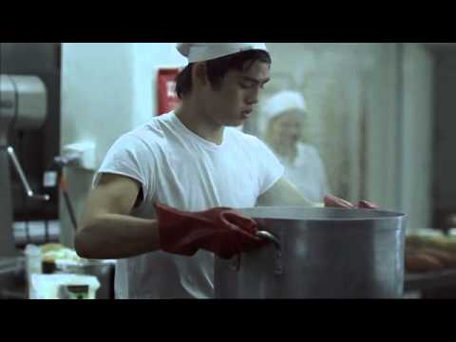
REMEMBER TO SPEAK UP!
WARNING: This video contains footage that some viewers may find distressing
Source: WorkSafe Victoria
Notes:
WARNING: This video contains footage some viewers may find distressing as it contains blood and persons being hurt.
SPEAKER’S DISCUSSION POINTS
Whether it’s through consultation at work or refusing to do work that’s unsafe, stop and talk to your supervisor, Health and Safety Representative (HSR) or union.
(Part 5 Division 6 Section 84 Right of worker to cease unsafe work)
ACTION
Step 1 - Play third video from WorkSafe Victoria (Kitchen) https://www.youtube.com/watch?v=-boMfnLnA6E Warning that incident occurs at approx. 0.23sec into video for people who wish to look away)
Taking a few minutes to stop and think about what you’re doing or ask someone for help could save your life.
Step 2 - Explore what they would have done in this situation. ‘So what should he have done or what should have happened to prevent the injury?
Reminder that we’ve discussed things around training and supervision, the right to safety equipment, the right to speak up about unsafe work, the right to consultation, amenities and first aid.
Reinforce messaging of Wait Take Five. This is a simple way to remember what actions you should take to stay safe.
1. Stop…...
2. Is it safe?
3. Could it hurt someone?
4. Speak up.
5. Ask. (for help or if they are not sure)

Slide 10
QUIZ TIME
What is an example of something that could harm you in the workplace and what should you do about it?
Name one worker’s work health and safety right?
Whose responsibility is work health and safety?
Notes:
Answers
Hazards
Examples: Boiling hot water, oil burns, water on floor, nail gun (tools).
Solutions: Make sure its safe to remove it, use the appropriate PPE, tell someone, clean it up, not use equipment tools you haven’t been shown how to use properly.
Options include
to say “no” to unsafe work
be consulted with about safety
receive induction
be provided with PPE.
Everyone’s

Slide 11
BULLYING
Source: The Project Channel 10 - 15 March 2018
Notes:
ACTION
Play video - commence from 0:38sec
SPEAKER’S DISCUSSION POINTS
Bullying is a serious issue in workplaces across NSW and a risk factor for anxiety, depression and suicide. Approx. 1 in 10 people are bullied in Australian workplaces.
Definition: Workplace bullying is any repeated and unreasonable behaviour directed at a worker or group of workers that creates a risk to health and safety.
Key elements to highlight:
Repeated behaviour refers to the persistent nature of the behaviour and can involve a range of behaviours over time.
Unreasonable behaviour means behaviour that a reasonable person, having considered the circumstances, would see as unreasonable, including behaviour that is victimising, humiliating, intimidating or threatening. Examples of workplace bullying includes things like repeated:
practical jokes
being criticised or insulted
rumours being spread about you
being threatened with losing your job
being overloaded with work.
Everyone in the workplace has a role to play when it comes to spotting and calling out bullying behaviour. Remember as previously discussed as a worker you have responsibilities to:
Follow policies and procedures
Participate in training
Report incidents of bullying
Participate in return to work plans if you have been injured or become sick because of work.
What you can do about bullying - You don't have to put up with bullying!
It can be difficult to tackle a bully on your own. Sometimes it's hard even if you do have the support of your friends. There are things that you can do and people to go to for help.
Talk to someone
Sometimes the best way to stop bullying is to tell an adult or someone in charge. You could tell:
a parent or guardian
a grandparent
your year coordinator
a teacher
a manager or colleague
a school counsellor
another adult you trust.
If that doesn’t work you can contact SafeWork NSW to make a complaint.
BACKGROUND INFORMATION: The following sections provides significantly more detail if required.
COMPLAINTS ABOUT BULLYING
If you believe you have been bullied at work, you should read the information on our bullying pages. This includes information on how to make a complaint about workplace bullying.
WHAT SAFEWORK NSW CAN DO
Can only act on situations that fall within the scope of the Work Health and Safety Act 2011 (WHS Act).
This includes verifying an employer or business (or other PCBU) is:
consulting with workers about work health and safety
providing and maintaining a work environment that is without risks to health and safety
providing and maintaining safe systems of work
monitoring the health and safety of workers and the conditions at the workplace, to ensure that work-related illnesses and injuries are prevented
providing appropriate information, instruction, training or supervision to workers and others at the workplace, to allow work to be carried out safely.
WHAT SAFEWORK NSW CANNOT DO
There are some things we cannot do. These include:
mediate between the workplace parties involved
provide legal advice
provide counselling
order the employer or business (or other PCBU) to discipline the alleged bully or terminate their employment
take sides
deal with industrial matters or discrimination
issue an order to stop bullying behaviour - the Fair Work Commission have powers to issue these orders if required.
WHAT YOU CAN EXPECT FROM SAFEWORK NSW
We will acknowledge in writing that we have received your request.
We may contact you for more information.
We will decide on the most appropriate action by assessing the information you provide and the circumstances of your request, and by considering our compliance policy and prosecution guidelines we will contact the workplace to which the issue relates (or the place from which the relevant person generally conducts their business or undertaking) by one of the following methods:
letter
phone call
visit by an inspector.
We will take care to not disclose any information that may identify you if you have made a request for your identity to remain confidential. However, it is possible that the workplace parties will make assumptions about who has raised the issue with us. In some circumstances, remaining anonymous may limit the scope of our action.
We will be transparent with the workplace about why contact is being made and what their obligations are under the WHS Act. If a visit is undertaken, the inspector will make enquiries to:
assess the extent of compliance by the workplace duty holders with their work health and safety obligations in relation to the alleged bullying issues
support compliance with legislation.
We will not, in most circumstances, take steps to verify that bullying has occurred. Our primary purpose is to assess the extent of compliance with WHS laws and ensure compliance, not to support a person's version of events over another or examine a potential breach of a code of conduct (although this may occur whilst we are making our enquiries).
Within 10 working days from receipt of your request, we will respond to your request which may include contacting you and/or the workplace.
We will keep you informed of progress, and when finalised, will provide you with the outcome, the reason for the decision and any actions taken. This will usually be via a phone call.
We will ensure that our decisions and actions are reasonable, fair and appropriate to the circumstances, based on consideration of all relevant legislation, policies and procedures.
We take unreasonable behaviour seriously. The Customer Service Standard outlines our standards of service. We do not view abuse, threats, intimidation or harassment of our staff by customers as part of their job. If your behaviour is unacceptable, we may set limits or conditions on your contact with us and provide you with a warning. If your unacceptable behaviour continues, we may cease all direct contact with you.
We may not be in a position to continue to respond to issues that have already been actioned by us. We may stop responding to you if we have already investigated and responded to your issues. If you have been provided with an opportunity to express your concerns, have been treated fairly, given reasons for decisions made and a reasonable explanation as to why your request can go no further, the matter will be closed. Any further correspondence from you about matters already dealt with will be noted, and no further action will be taken.
IMMEDIATE EMOTIONAL SUPPORT
If you need emotional support, the following services may help:
Lifeline on 13 11 14 – 24-hour counselling service providing emotional support in times of crisis
Mental Health Line on 1800 011 511 – 24-hour support service across NSW that can connect you with a mental health professional
Headspace on (02) 9114 4100 – a national youth mental health foundation that helps young people between 12 and 25 who are going through a tough time.
A STOP BULLYING ORDER
If you believe you have been bullied at work, you may be eligible to apply to the Fair Work Commission for an order to stop the bullying.
YOUR RIGHTS AT WORK
Contact the Fair Work Ombudsman if the issue is about:
not being paid the right amount
being forced to do things against your will
being discriminated against
not getting the right amount of leave or other conditions you're entitled to
being threatened by your employer
a sham contract.
UNFAIR DISMISSAL
Contact the Fair Work Commission if the issue is about unfair dismissal or unlawful termination.
VIOLENCE OR THREATS OF VIOLENCE
Contact NSW police if the issue involves physical violence or the threat of it, or contact us (SafeWork NSW) if it involves work-related violence.

Slide 12
DISCRIMINATION AND HARASSMENT
Discrimination
Harassment
Discrimination occurs when someone is treated unfairly because they belong to a particular group of people or have a particular characteristic.
Anti-discrimination law defines harassment as any form of behaviour that:
you do not want
offends, humiliates or intimidates you
creates a hostile environment.
Notes:
SPEAKER’S DISCUSSION POINTS
Unreasonable behaviour (is one part of the definition of bullying) may involve unlawful discrimination or harassment, which in isolation is not workplace bullying (as it’s not repeated). However discrimination on the basis of a protected trait (see types of discrimination below) in employment may be unlawful under anti-discrimination, equal employment opportunity, workplace relations and human rights laws.
Under NSW law it is illegal to discriminate against someone because of age disability, homosexuality, marital status, race, sex, transgender status, or carer’s responsibilities. NSW Anti Discrimination Act makes discrimination unlawful in the area of employment, public, education, accommodation, the provision of goods and services and in registered clubs.
Important difference: Harassment and discrimination, unlike bullying, may occur only once. You don’t have to put up with it multiple times. Once is enough.
Valuing and respecting people’s differences is in everyone’s interest!

Slide 13
WORKPLACE VIOLENCE
!
Workplace violence is a criminal offence and should be reported to the police.
Immediately after a violent incident, you should:
ensure that everyone is safe
provide first aid or urgent medical attention where necessary
report what happened, who was affected, and who was involved. (If you are unsure you can ring the Police and SafeWork NSW for advice)
keep a record of what happens (including what was said and by who) and hang onto any evidence (like medical certificates, workers compensation claims and any physical evidence like emails or photos).
Notes:
SPEAKER’S DISCUSSION POINTS
Responses to work-related violence will vary depending on the nature and severity of the incident. Systems should be in place that document what to do at the time of, and immediately after, an incident.
Examples of work-related violence can include:
biting, spitting, scratching, hitting, kicking
pushing, shoving, tripping, grabbing
throwing objects
verbal threats
threatening someone with a weapon, armed robbery
sexual assault.
What you can do about it
Workplace violence counts as criminal behaviour and can be punishable by law. If you think you’ve been the victim of a crime (for example, if someone causes you serious injury) you should make a statement at your local police station.
You don't have to put up with violence. NSW law says that you have the right to refuse to work if you’re in immediate danger.
Contact NSW police if someone (including customers or other workers) have been physical violent or threat it and SafeWork NSW if it involves work-related violence.
BACKGROUND INFORMATION
31% of mental stress claims were made by workers under 20 years from exposure to workplace violence. 26% made by workers aged 20-27 years (Statistics for the violence/bullying infographic have been sourced from the below SWA reports: Safe Work Australia’s National Data Set for Work-related mental disorders profile
Safe Work Australia’s National Data Set for Bullying and Harassment in Australian Workplaces: results from the Australian workplace barometer project 2014/2015)
If the police do not apply for an Apprehended Violence Order (AVO) on your behalf you can make a private application. For more information, see Applying for an AVO through the Local Court - Step by step guide go http://www.lawaccess.nsw.gov.au/Pages/representing/lawassist_avo/lawassist_gettingavo_home/lawassist_applying_avo/lawassist_apply_avo_police.aspx. If the protected person is a person under the age of 16, only the police can apply for an AVO on their behalf.
If you need legal advice LawAccess NSW is a free government telephone service that provides legal information, referrals and in some cases, advice for people who have a legal problem in NSW. You can call 1300 888 529 between 9am to 5pm, Monday to Friday (excluding public holidays).

Slide 14
WORKERS’ COMPENSATION
Workers’ compensation includes payments to workers to cover their:
wages while they're not at work
medical expenses and rehabilitation.
Use the ‘Have you been injured at work tool’ to understand your entitlements - www.sira.nsw.gov.au
Employers in each state or territory have to take
out workers’ compensation insurance to protect their workers if they have a work-related injury or illness.
Notes:
SPEAKER’S DISCUSSION POINTS
You don’t necessarily have to be in a typical ‘employee’ relationship to be covered by workers compensation. Workers compensation can cover both workers and contractors, if you are a contractor and injured check with your employer or State Insurance Regulatory Authority (SIRA) if you are eligible.

Slide 15
QUIZ TIME
What types of behaviours in the workplace could be classified as bullying?
When you are injured at work, what are the first steps you should take?
If you are hurt or get sick at work, who pays for your medical treatment?
Notes:
Answers
Repeated episodes of being criticised or insulted, rumours being spread about you, being threatened with losing your job, being overloaded with work.
The first thing you should do is get first aid, go to a doctor or hospital to get appropriate treatment for your injury. Also you need to let your boss know what happened as soon as you can.
If you're a worker...
I. You must notify your employer that you've sustained a work related injury or illness.
Give them:
the date and time of the injury, or the period over which the injury or illness emerged
a description of how the injury happened
a description of the injury.
II. You can also notify your employer's insurer as well if you wish.
To learn more, please refer to the Guidelines for claiming workers compensation or call 13 10 50.
3. My employers workers compensation insurer.
Reinforce messaging of Wait Take Five. This is a simple way to remember what actions you should take to stay safe.
1. Stop…...
2. Is it safe?
3. Could it hurt someone?
4. Speak up.
5. Ask. (for help or if they are not sure)

Slide 16
EVERY INJURY HAS ITS OWN STORY
TIP
Wait Take Five
Stop…..
Is it safe?
Could it hurt someone?
Speak up.
Ask.
Notes:
ACTION - Depending on your audience play the either Tiffany’s, Joany’s or Tim’s story
WARNING: Tiffany’s story contains footage some viewers may find distressing as it contains images of injuries.
SPEAKER’S DISCUSSION POINTS
The film In it for the long haul: The Tiffany Ward Story, is an example of what can go wrong.
In 2008, Tiffany was 18 when both her arms were trapped and dragged into a potato processing machine at work.
Tiffany’s film tells of the physical and emotional impact that a work related injury can have on someone, particularly a young person, their future and those around them.
Reinforce messaging of Wait Take Five. This is a simple way to remember what actions you should take to stay safe.
1. Stop…...
2. Is it safe?
3. Could it hurt someone?
4. Speak up.
5. Ask. (for help or if they are not sure)

Slide 17
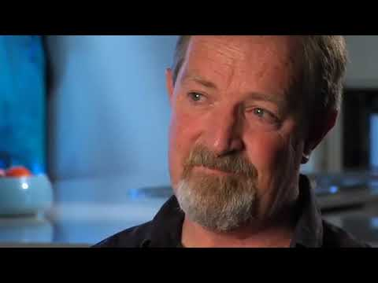
EVERY INJURY HAS ITS OWN STORY
TIP
Wait Take Five
Stop…..
Is it safe?
Could it hurt someone?
Speak up.
Ask.
Notes:
ACTION - Depending on your audience play the either Tiffany’s, Joany’s or Tim’s story
SPEAKER’S DISCUSSION POINTS
Tim was a second year electrical apprentice when he was involved in a fatal incident.
What was meant to be a routine electrical task, ultimately cost him his life. As a young worker at only 17 years of age, Tim didn't have the experience and skills to do this job by himself without adequate supervision and guidance.
Forever young – Tim's story is told by Bill Martin, Tim's father who now lives with the consequences of a terrible and unnecessary workplace incident.
Reinforce messaging of Wait Take Five. This is a simple way to remember what actions you should take to stay safe.
1. Stop…...
2. Is it safe?
3. Could it hurt someone?
4. Speak up.
5. Ask. (for help or if they are not sure)

Slide 18
EVERY INJURY HAS ITS OWN STORY
TIP
Wait Take Five
Stop….
Is it safe?
Could it hurt someone?
Speak up.
Ask.
Notes:
ACTION - Depending on your audience play the either Tiffany’s, Joany’s or Tim’s story
SPEAKER’S DISCUSSION POINTS
Joany’s film tells of the physical and emotional impact that a work related injury can have on someone, particularly a young person, their future and those around them.
Reinforce messaging of Wait Take Five. This is a simple way to remember what actions you should take to stay safe.
1. Stop…...
2. Is it safe?
3. Could it hurt someone?
4. Speak up.
5. Ask. (for help or if they are not sure)

Slide 19
SUMMARY
Wait Take Five
Stop….
Is it safe?
Could it hurt someone?
Speak up.
Ask.
Your employer must provide:
a psychologically and physically safe and healthy workplace
safe equipment, structures and systems of work
adequate workplace amenities and facilities
induction information, training and supervision
the opportunity for you to talk about work health and safety
workers compensation insurance protection
basic information about what to do if you have a work-related injury or illness.
Notes:
Reinforce messaging of Wait Take Five.
1. Stop…..
2. Is it safe?
3. Could it hurt someone?
4. Speak up.
5. Ask. (for help or if they are not sure)

Slide 20
Contact SafeWork NSW safework.nsw.gov.au 13 10 50 contact@safework.nsw.gov.au
Notes:
This is the last slide in the main presentation. However the following slides are additional.

Slide 21
Additional slides
The following slides have been included as additional resource material which can be included in the main presentation if time permits or in a separate session.
While we were consulting young workers and others during the development of the eToolkit, the following topics were consistently raised.

Slide 22
Purpose of slides 22 to 26
Whilst trialling the learning resource, young workers frequently asked questions about the right pay and rights to breaks.
We have sourced this information from the Fair Work Ombudsman website for your reference.

Slide 23
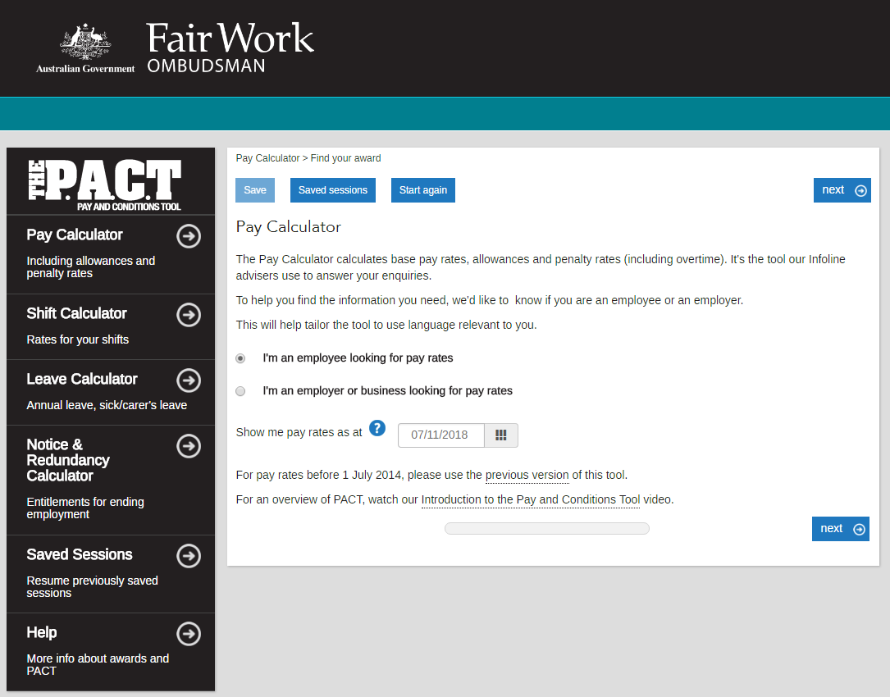
RIGHT TO FAIR PAY
Available at www.fairwork.gov.au
Notes:
The Pay and Conditions Tool (the P.A.C.T) is made up of 4 calculators for:
pay rates - includes penalty rates and allowances
shift calculations - a sum of pay rates for up to 4 weeks of shifts
annual and sick leave
notice and redundancy entitlements.
Who can use the Pay and Conditions Tool?
The tool helps you find and calculate your minimum award pay rates and entitlements for the Fair Work System. The leave and ending employment calculators also allow you to find an entitlement without entering an award. To check if you are covered by the Fair Work System, go to our Fair Work System page.

Slide 24
UNPAID ‘VS’ PAID WORK
Vocational placement
Mitchell is choosing electives for his undergraduate degree.
One of the electives is a three month placement organised by his university at a host business.
The placement counts as credit towards finishing his degree.
As the placement is part of his course, it meets the definition of a vocational placement.
This means he’s not an employee and not entitled to be paid wages or get other conditions of employment.
Not a vocational placement
Stuart recently finished a Bachelor of Journalism and is looking for work.
He responds to an advertisement to write for his local paper for three months as an ‘unpaid intern’.
He wants to get experience and increase his chances of employment.
Since Stuart has already finished his degree and the placement wasn’t required by his course, it isn’t a vocational placement.
The paper tells Stuart that he’ll be given specific tasks with deadlines and that he’s expected to be at work in normal business hours.
This suggests Stuart has been engaged as an employee and entitled to wages and other conditions.
Notes:
Many young workers find themselves in a situation where they are not being paid for work when they should be. Here are some examples to help distinguish what is paid vs unpaid work.
Sourced - https://www.fairwork.gov.au/pay/unpaid-work/student-placements

Slide 25
UNPAID WORK ‘VS’ PAID
Unpaid internship
A local council has advertised an internship program for high school or university students interested in government processes.
The internships have been advertised as unpaid positions and students are allowed to select the hours they spend at the council office over a two week period.
The council is careful to make sure that the role is mainly observational.
The students are getting the main benefit from the arrangement.
In this example there’s no employment relationship and the interns don’t have to be paid.
Paid internship
Jonathon is a final year accounting student.
He agreed to do an unpaid internship with an accountancy firm and was promised a job once he graduates.
Jonathon attended the firm for three days a week.
He prepared customer tax returns and company financials.
The firm charged clients for the work he did.
Although Jonathon had agreed not to be paid, he did work that would have otherwise been done by a paid employee.
This indicates an employment relationship existed. As such he should be paid for all the hours he worked.
Notes:
Many young workers find themselves in a situation where they are not being paid for work when they should be. Here are some examples to help distinguish what is paid vs unpaid work.
Sourced - http://www.fairwork.gov.au/pay/unpaid-work/work-experience-and-internships

Slide 26
UNPAID ‘VS’ PAID WORK
Lawful unpaid trials
Jack applies for a job as a trades assistant at a local panel beaters.
As part of the applicant screening process, Jack is advised by the owner that on the day of the interview he'll need to show he knows his way around a car and a workshop, because it's a minimum requirement of the job.
Jack agrees.
To do this, after the interview, Jack is asked to follow one of the tradesmen doing body repairs.
The tradesman watches Jack to make sure he knows how to work safely and use the right tools.
Jack shows he meets the minimum criteria for the role and the owner offers Jack the job.
Jack's brief trial was reasonable to demonstrate his skills and he does not need to be paid for the trial.
Unpaid trials that should be paid
Jessica sees an advertisement on her university notice board for a job as a barista at a campus café.
The position was advertised for Monday, Tuesday and Thursday mornings from 7 am to 12 pm.
The successful candidate needs to have at least three years' experience and be able to make a wide range of coffees.
At her interview, Jessica is advised that she will need to work the first week unpaid to give the café manager time to see whether or not she is suitable for the job.
She is also advised that if she isn't able to work any of the shifts in the first week, she needs to advise the manager the night before and arrange someone to cover her shift.
The duration of the 'trial' and the requirements placed on Jessica suggest that the arrangement is an employment relationship, meaning that she should be paid for all hours worked at the appropriate minimum rate of pay.
Notes:
Many young workers find themselves in a situation where they are not being paid for work when they should be. Here are some examples to help distinguish what is paid vs unpaid work.
Sourced - https://www.fairwork.gov.au/pay/unpaid-work/unpaid-trials

Slide 27
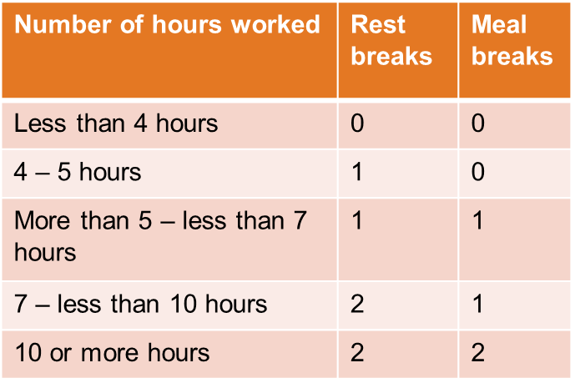
RIGHT TO LEAVE AND BREAKS
Employees can take leave for many reasons:
long service leave
public holidays
community service
maternity and parental leave
compassionate and bereavement leave
sick and carer leave
annual leave
An employee gets the following number of breaks, depending on the hours they actually work (not their rostered hours).
Notes:
Minimum leave entitlements for employees come from the National Employment Standards (NES). An award, registered agreement or contract of employment can provide for other leave entitlements but they can’t be less than what’s in the NES.
A rest break is a 10 minute paid break that counts as time worked.
A meal break is a 30 - 60 minute unpaid break that doesn’t count as time worked, except for shift workers.
Meal breaks for shift workers are paid and count as time worked.
An employee gets the following number of breaks, depending on the hours they actually work (not their roistered hours).
Taking breaks
The time to take breaks and the length of breaks form part of an employee’s roster. This means an employee has to be told about when to take their breaks and how long they are.
An employee who gets 2 rest breaks has to take 1 break in the first half of their shift, and the other break in the second half of their shift.
Employees can't be asked to:
take a rest or meal break within 1 hour of starting or finishing work
take a rest break combined with a meal break
work more than 5 hours without a meal break.
When a meal break isn't given
There is no extra payment (eg penalty rate) for not getting a meal break.
Breaks between shifts
Employees have to get a minimum break of 12 hours between finishing work on one day and starting work the next day.
An employer and employee can agree to reduce the break to between 10 and 12 hours.
If an employee doesn't get a break between shifts
When employees don't get a 12 hour break between shifts and they start at their normal shift time the next day they get paid:
double time for the hours they work, until they are released from duty to have a 12 hour break between shifts and
when they eventually get their break between shifts, the ordinary hourly pay rate for any ordinary hours they don't work because they are taking the break.
When employees get a 12 hour break between shifts but start work later than their normal shift the next day so they get a break they get paid:
for all the hours they work
the ordinary pay rate for the hours between when they were originally rostered to start work and when they actually started work.

Slide 28
Purpose of slides 28 to 31
Slide 28: Disclosure of a disability (including mental health). The legal requirements and privacy laws are still not well understood.
Slide 29: Spot the hazard is a fun activity to help identify things that can harm you.
Slide 30: Hierarchy of controls are an important safety concept to understand.
Slide 31: This slide can be used as an extra activity if you have time to workshop strategies and reinforce learning outcomes.

Slide 29
DISCLOSURE
Under the Australia-wide Privacy Act 1988 an employee’s condition can’t be shared with anyone without his or her permission.
Any information can only be used for the purposes for which it was disclosed, such as arranging adjustments in the workplace to support the employee.
Tip
There is no right or wrong answer when it comes to telling people about mental health, especially in the workplace.
Weigh up the options.
Consider when would be the best time to disclose.
Decide who to disclose to.
Notes:
There’s no right or wrong answer when it comes to telling people at work about your mental health condition. Whether you choose to tell others can depend on how much your condition affects your role, the amount of support you have outside the workplace and your relationships with your colleagues.
Disclosure tool - https://www.headsup.org.au/your-mental-health/talking-about-a-mental-health-condition-at-work/disclosure-tool

Slide 30
SPOT THE HAZARD
Notes:
ACTION – hand out spot the hazard handout (go to SafeWork NSW website, Young Worker toolkit, Educator section, below the presentation)
Question - How many hazards can you find?
Answer -
Tractor is turned on without a driver in the seat.
Farmer not wearing his protective clothing when pouring the chemicals which are also spilling.
Farmer standing on wobbly pipes.
The long pipe he is holding is too close to power lines.
Driver has only one hand on the wheel and he is not wearing hearing protection.
Child sitting on the guard.
Tractor has no Roll-over Protective Structure (ROPS).
No guards on slasher and power take-off (PTO).
Farmers smoking near petrol.
Farmer sitting on the truck smoking while grain is being unloaded.
Hazardous chemicals are not locked away.
Sheep in overfilled pen with farmer working inside.
Rubbish on ground.
Incorrect use of quad bike: farmer carrying a child as a passenger and a big, heavy tank on the back. He is not wearing a helmet.
Farmer in the silo.
Unguarded drive pulleys on the auger.
Farmer standing over the power take-off shaft.
He is also not wearing the correct clothing for sun protection.
Farmer standing on wobbly surface using a chainsaw.
He is underneath the tree he is cutting.
He is not wearing safety gear.
Unguarded post hole digger/driver.
Small children wandered off with no adult supervision, playing near the edge of the dam.
Farmer is not bending or lifting properly and has his back turned to the angry bull.
Open hatch on silo. Child climbing ladder. Ladder is not secured and doesn’t stop access to it.
Now introduce the hierarchy of controls (slide 10) and you could workshop with one of the hazards identified. Or you could use the example in the speaker notes in slide 10.

Slide 31
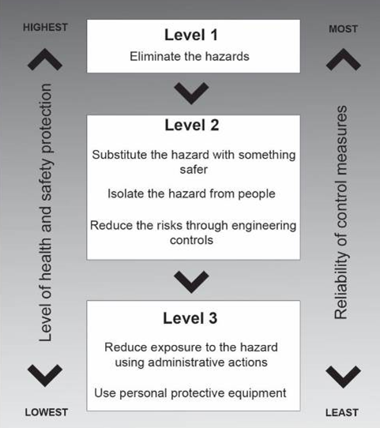
HIERARCHY OF CONTROLS
Notes:
SPEAKER’S DISCUSSION POINTS
Walk through an example
Slips, trips and falls
Slips occur when a person's foot loses traction with the ground surface, trips occur when a person unexpectedly catches their foot on an object or surface. Falls may result from a slip or trip but many occur during falls from low heights or into a hole, ditch or body of water.
Risk
Slips and trips result in thousands of injuries each year with the most common injuries being musculoskeletal. Cuts, bruises, fractures, dislocations and more serious injuries also occur.
Remedy
Using a hazard identification and risk management process the hierarchy of controls can mitigate risks involved with slips, trips and falls at every level. For example;
Hierarchy of Control
Eliminate the hazard
Remove slip and trip hazards at the design stage such as eliminating changes in floor levels and installing more power outlets to avoid trailing cords.
Substitution
Replace flooring with a more slip-resistant surface.
Isolation
Prevent access to high risk areas, for example cordon off wet floor areas while cleaning is in progress.
Engineering controls (redesign)
Apply floor treatments to increase slip resistance, Improve lighting, Stop leaks from equipment or pipes, Provide adequate drainage, Clearly mark edges of steps and any changes in floor heights.
Administrative controls
Implement good housekeeping practices including keeping access ways clear and cleaning up spills promptly, Use signage to warn of wet or slippery areas, Provide training and supervision.
Personal protective equipment
Wear slip-resistant footwear.
Example sourced from Comcare https://www.comcare.gov.au/preventing/hazards/physical_hazards/slips,_trips_and_falls

Slide 32
YOUNG WORKERS’ OWN EXPERIENCES
“You have to consistently be polite to rude and sometimes cruel customers. This is pretty related to Trip Advisor and the stigma in a rural town of having to keep a high rating even if it means putting up with rude customers.”
Female, 23, Food Service Assistant
“I would like to know more about how to handle workplace bullying as at the moment I feel like I am being bullied by my co-worker and our supervisor. I want to face this issue the wise and smart way not just me getting sick of it then just ready to explode.”
Female, 19, Waitress
“[I] was being harassed, [I] was told to pretend it never happen.”
Male, 29, Forklift Driver
“I was asked to work early and late at age 15-16, without any supervision. At this time I was solicited for sex by a customer …I said no and kept working.”
Female, 21, Integration Aid
I feel that sexual harassment is common at work that it isn’t treated as an issue. It’s a daily occurrence and I would be pinpointed as sensitive if I felt uncomfortable by some of the vulgar comments made by customers daily.”
Female, 23, Gaming Supervisor
Sourced from – http://www.youngworkers.org.au/publications
Notes:
You can use these quotes to generate discussion and provoke questions.
Or
As an activity for the class, ask what they would do in these situations, knowing what you know now?
Comments sourced from - http://www.youngworkers.org.au/publications

Slide 33
Contact SafeWork NSW safework.nsw.gov.au 13 10 50 contact@safework.nsw.gov.au

