Slide 1
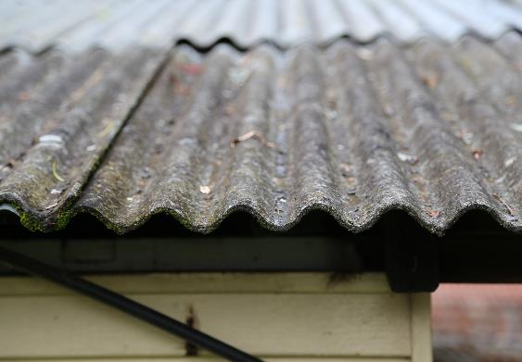
The dangers of cleaning asbestos roofs
Communication pack – November 2021
SafeWork NSW

Slide 2
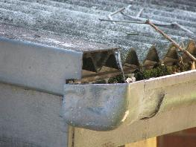
Introduction
When high pressure water is used to clean asbestos roofs it can cause widespread asbestos contamination, which may lead to inhalation of asbestos fibres.
SafeWork NSW have responded to many incidents resulting in widespread asbestos contamination and extensive clean-up costs.
High-pressure cleaning asbestos roofs effects not only the property being cleaned but neighbouring properties as well.
Asbestos contamination incidents often receive significant media attention.
This pack has been developed to help your organisation share important information about pressure cleaning asbestos roofs with your community. It includes:
A3 poster and DL (envelope size) flyer
social media posts
newsletter articles
video links
images
information on what to do in the event of an asbestos contamination.
For more information please email: asbestosdemolitionservices@safework.nsw.gov.au

Slide 3
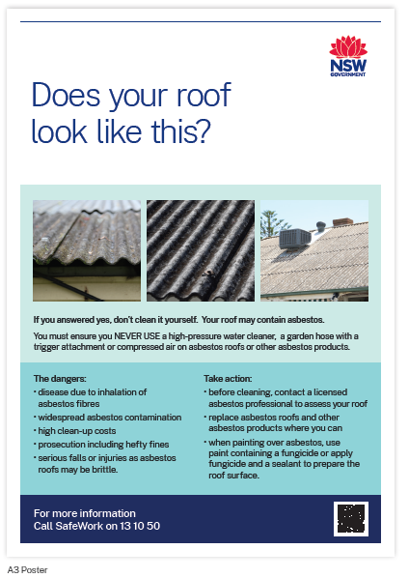
A3 poster
A single page poster in English explaining the dangers of using a pressure spray on asbestos roofs and alternatives.
Click here to download the hi-res version suitable for commercial printery (Includes trim and crop marks).
Visit the SafeWork NSW website to download the poster in other languages.

Slide 4
DL double sided flyer
A DL sized double sided flyer in English explaining the dangers of using a pressure spray on asbestos roofs and alternatives.
Click here to download the hi-res version suitable for printing in an office
Visit the SafeWork NSW website to download the poster in other languages.

Slide 5
Social media content
Included below is some content that can be used to share our video on pressure cleaning asbestos roofs across your social media channels.
Post text: Using high pressure water to clean asbestos roofs can lead to asbestos contamination, clean-up costs and serious health risks.
Image caption options: Never use high-pressure water or compressed air on asbestos products.
Video links:
YouTube: https://www.youtube.com/watch?v=pSqAkR9hQQo&feature=youtu.be
Vimeo: https://vimeo.com/418756390/b7c7be9859
Alternatively, choose an image from the image library on the following slides for an image only post.
You can also share the social media posts which will be published on SafeWork NSW’s social media channels throughout the year. Here’s the links to:
SafeWork NSW’s Facebook page SafeWork NSW’s LinkedIn page SafeWork NSW’s Twitter account

Slide 6
Video links
The video on the dangers of pressure cleaning asbestos roofs is available in these languages:
Arabic: https://youtu.be/5rwkKI5YwzM
Cantonese: https://youtu.be/8UTBu0jmgrU
Mandarin: https://www.youtube.com/watch?v=bjBuPryRrko
Vietnamese: https://youtu.be/y91VnBTvzuM
English: https://youtu.be/4Oaatqtc3bM

Slide 7
Newsletter content option 1
Think twice before pressure cleaning
An estimated 4,000 Australians are dying from asbestos related diseases each year due to past exposure. Inhalation of asbestos fibres can cause asbestos related diseases such as asbestosis, mesothelioma, and lung cancer.
Please don’t use high-pressure water, a garden hose with a trigger attachment or an air compressor to clean asbestos roofs.
High pressure water damages the surface of asbestos products meaning asbestos fibres can be released into the air putting your health, family members, workers and your neighbourhood at risk.
SafeWork NSW have reported multiple incidents where high-pressure water has been used to clean asbestos roofs on residential homes causing:
widespread asbestos contamination
extensive clean-up costs
residents and neighbours needing to relocate until properties could be remediated
possible inhalation of dangerous asbestos fibres.
If you are planning on cleaning or renovating an older roof, think twice about asbestos. First check whether it contains asbestos by contacting a licensed asbestos assessor at www.safework.nsw.gov.au/asbestos.
If you suspect asbestos contamination due to pressure cleaning contact SafeWork NSW on 13 10 50.
Note: Images and video links included in this pack can also be shared with the newsletter content.

Slide 8
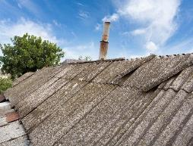
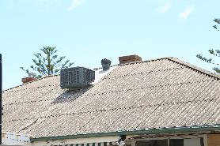
Newsletter content option 2
Does your roof look like this?
It’s critical that you never use (or engage anyone else to use), high-pressure water or a garden hose with a trigger attachment to clean these roofs, as all they contain asbestos.
High pressure water damages the surface of asbestos products, meaning asbestos fibres can be released into the air, putting your health, workers, and that of your neighbours at risk.
An estimated 4,000 Australians are dying from asbestos related diseases each year due to past exposure. Inhalation of asbestos fibres can cause asbestos related diseases such as asbestosis, mesothelioma, and lung cancer.
Previous incidents where high-pressure water has been used to clean asbestos roofs on residential homes have caused serious problems including:
widespread asbestos contamination
extensive clean-up costs
residents and neighbours needing to relocate until properties could be remediated
possible inhalation of dangerous asbestos fibres.
If you are planning on cleaning or renovating an older roof, think twice about asbestos. First check whether it contains asbestos, by contacting a licensed asbestos assessor. A list of licensed asbestos assessors can be found at www.safework.nsw.gov.au/asbestos. If you suspect asbestos contamination due to pressure cleaning contact SafeWork NSW on 131050.

Slide 9
Images – asbestos roofs
The images included here can be used across your channels with the content included on previous slides. To download, right click on tile and select ‘save as picture’ or click the link above each image for a higher resolution version.
Click here to download hi-res image
Click here to download hi-res image
Click here to download hi-res image

Slide 10
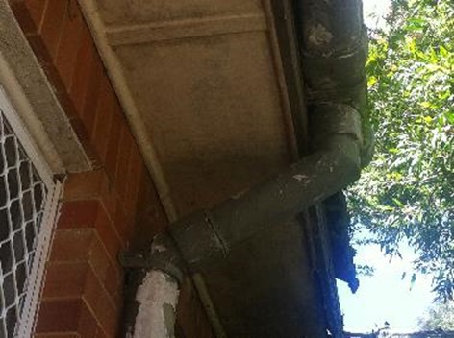
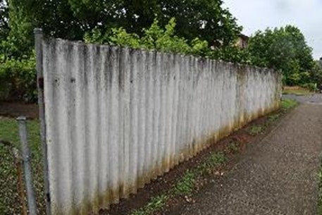
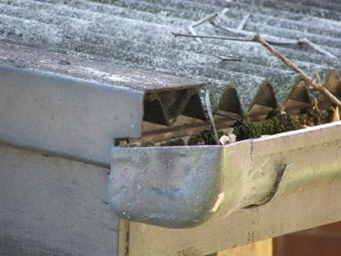
Images – asbestos containing materials
The images included here can be used across your channels with the content included on previous slides. To download, right click on tile and select ‘save as picture’ or click the link above each image for a higher resolution version.
Click here to download hi-res image
Click here to download hi-res image
Click here to download hi-res image

Slide 11
National Asbestos Awareness Week
22 - 28 November 2021 is National Asbestos Awareness Week. This is a great opportunity to promote the dangers of pressure cleaning asbestos roofs, as well as support the national campaign by raising awareness about the dangers of asbestos.
You can support the national campaign by sharing the material provided in the Asbestos Safety and Eradication Agency campaign pack available at https://www.asbestossafety.gov.au/naaw-2021
11

Slide 12
What to do in the event of an asbestos contamination incident
At your home
If you have used a pressure cleaner on a an asbestos roof on your own home, your council is required to coordinate the clean up.
Contact your local council
At your work
If a contractor has been engaged to clean a roof of a residential property
if it is a commercial property.
Then these scenarios are deemed to be a workplace and SafeWork NSW must be notified of the incident.
For more information on staying safe when working with asbestos, visit the SafeWork NSW website.
If you suspect asbestos contamination due to pressure cleaning, immediately contact SafeWork NSW on 13 10 50.

Slide 13
More communication and marketing resources
SafeWork NSW resources
Resources for the Asbestos Awareness Week campaign https://www.safework.nsw.gov.au/resource-library/asbestos-publications/asbestos-awareness-week/asbestos-week
https://www.safework.nsw.gov.au/advice-and-resources/campaigns/asbestos-awareness
SafeWork YouTube Asbestos video playlist
https://www.youtube.com/playlist?list=PLbi-niu1pEg1Lypi9V2lsCDXxgDmto5gx

Slide 14
Tips for using information in this pack
When sharing information about the dangers of cleaning asbestos roofs, it's important the messaging is appropriate to your audience.
Here are some tips:
Use the captions and content we have provided for social media posts and newsletter content.
Use the web link www.safework.nsw.gov.au/asbestos to support the promotions where possible.
Refer to ‘SafeWork NSW’.
Please contact us if you have any questions asbestosdemolitionservices@safework.nsw.gov.au

